Slide 1

Data Analysis for Talent Management
By Jayson Baker & William Hinton

Slide 2
Talent Attrition: Key Points
Could be due to a number of factors and we are here to identify the most common factors.
We will identify certain factors and then run a Linear Regression Model to show us the best fit model that identifies key elements why an employee would stay or leave a company.
What we mean by best fit, is there are certain variables that plays a factor into why certain departments have high turnovers in employees.
We want to identify these departments and some predictors behind why someone would leave or why they are staying at the company.
After identifying the contributing factors, we will use Tableau to drill down a little bit farther to get a wholistic view point of what is going on with attrition in this company attrition.

Slide 3
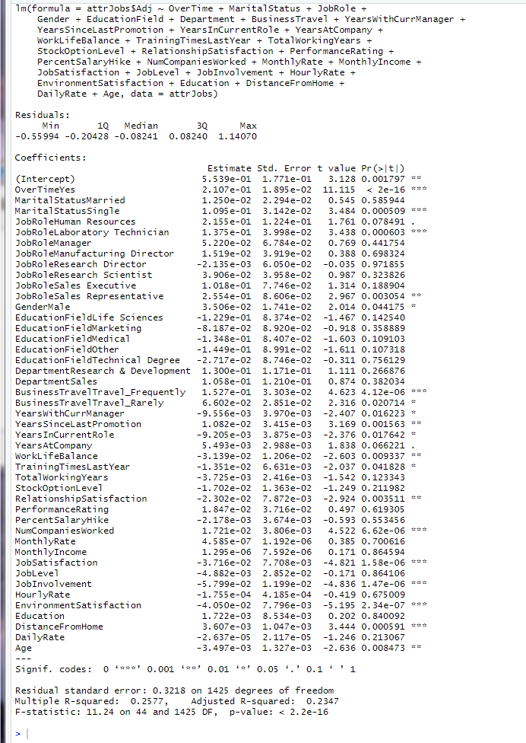
We set our predictor to numeric 1 or 0. #set no/yes to 0,1 attrJobs$Adj[attrJobs$Attrition=="Yes"]<-1 attrJobs$Adj[attrJobs$Attrition=="No"]<-0
We will take these variables and eliminate the ones that has an high p-value. If the p-value is greater than 0.05, we will eliminate that variable from the model.

Slide 4

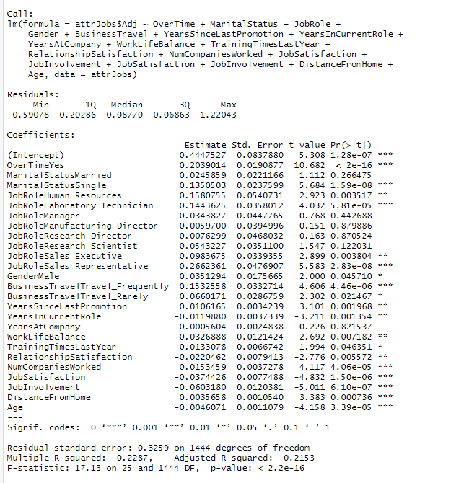
This is the reduce model
We eliminated variables that wee not needed. You still see we are not satisfied. We will use the Stepwise in the next model.

Slide 5


Slide 6
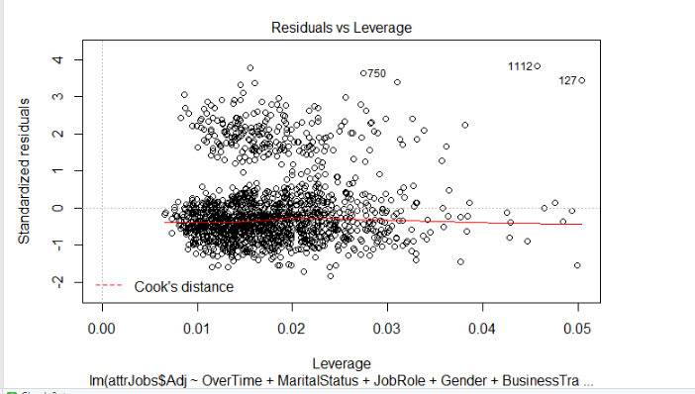

Slide 7
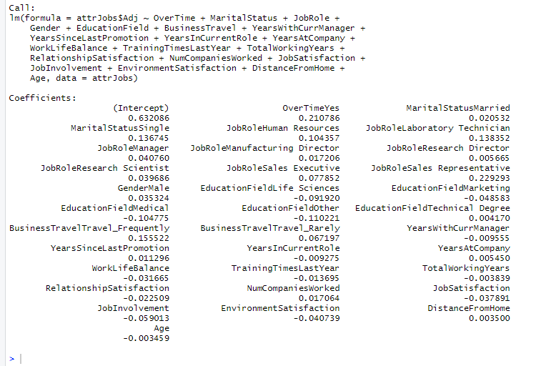
The model that fits.
We will use these coefficient to drill down a little farther in Tableau. We can make predictions and conduct analysis dynamically on the fly with Tableau.

Slide 8
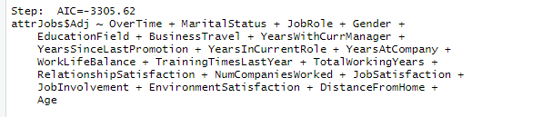
Due to the small value in the AIC which is Akaike Information Criterion along with the Adjusted R-square 0.2378 and p-value of 2.2e-16.We concentrated that addition analysis to be performed in Tableau which can predict what are the causes of job attrition. https://public.tableau.com/profile/jayson.barker#!/vizhome/DS6306_CS2/Dashboard1

